Slide 1
Applied Data Science 2
Dr Ashley SpindLer
Semester A, 2023

Slide 2
Lecture 2 - Outcomes
Introduce Apache Spark and what it is used for
Demonstrate Spark SQL with PySpark
Understand the core elements for this course: RDDs, DataFrames, Transformations and Actions

Slide 3
Apache Spark

Slide 4

What is Apache Spark
Open Source, unified engine for large scale data processing
Implicit parallel computation with a high fault tolerance
Highly scalable even to petabyte-scale analysis

Slide 5
Spark Benefits
Fast – queries are optimised on the fly, spark works to minimise I/O operations
Easy to Use - Spark is designed with simplicity in mind, with a programming model built on transformations and actions
Unified – Querying, streaming, machine learning and graph processing are all unified under Spark

Slide 6
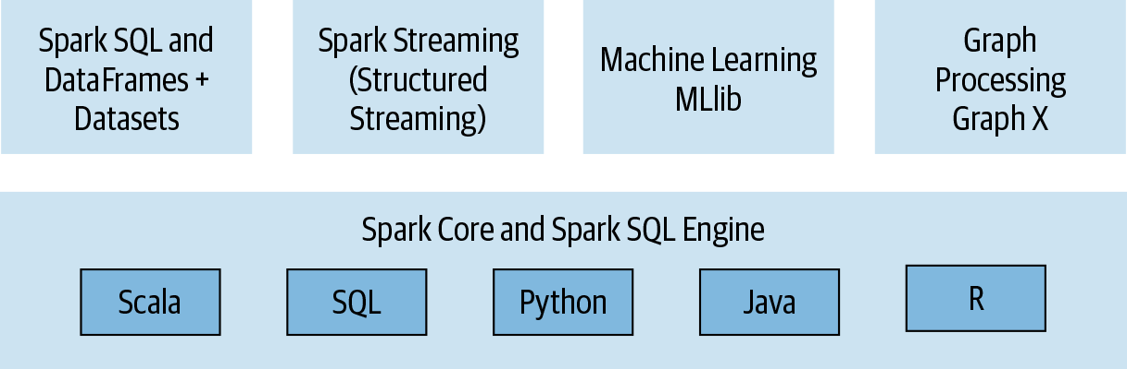
Unified Stack
Apache Spark Components and API Stack

Slide 7
Unified Stack
Apache Spark Components and API Stack

Slide 8
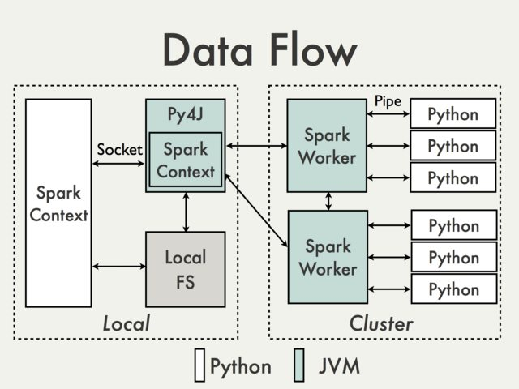
Data Flow in PySpark
PySpark is built on top of Spark’s Java API
The python code is called a “Driver” program, which includes a SparkContext—this is the entry point of the Spark API
The SparkContext uses “Py4J” to launch and communicate with Java Virtual Machines

Slide 9
SparkContext
Python Driver
SparkContext
Worker
Worker
Worker
Worker
Executor
Executor
Executor
Executor
Task
Task
Task
Task
Task
Task
Task
Task

Slide 10
Live Code Example

Slide 11
RDDs and DataFrames

Slide 12
Resilient Distributed Datasets – RDDs
RDDs are Lazily Evaluated – Transformation statements create a “Query Plan” that is only computed when an Action is used
RDDs can persist in memory – this precents computationally expensive I/O reads on slow disk drives
RDDs are Fault Tolerant and Immutable – the data can be efficiently shared across the application, and lost data easily rebuilt
RDDs are the fundamental data structure of Spark.
A Dataset in a Spark RDD is divided across a cluster in logical partitions, and are evaluated in parallel

Slide 13
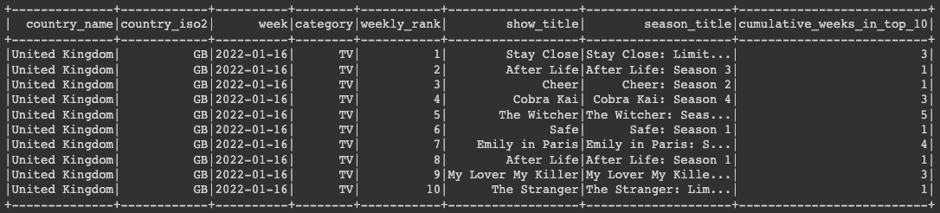
DataFrames
DataFrames are RDDs which group data into named columns

Slide 14
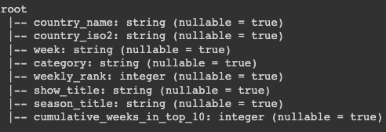
DataFrame Schema
The Schema of a DataFrame defines the names of the columns, the data types, and whether the data is nullable.
df.printSchema()

Slide 15
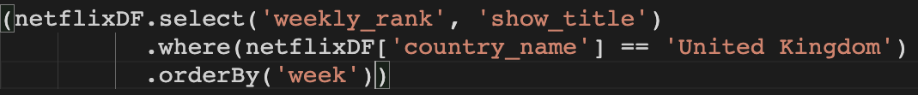
DataFrame Transformations
Methods that return a new DataFrame and are Lazily Evaluated

Slide 16
DataFrame Actions
Actions are methods that trigger computation
df.count()
df.collect()
df.show()

Slide 17
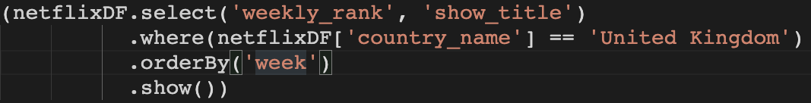
Actions Trigger Transformations

Slide 18
DataFrame Columns
Accessing Columns
df["columnName"]
df.columnName
col("columnName")
col("columnName.field")
Creating Columns with Expressions:
col("a") + col("b")
col("a").desc()
col("a").cast("int") * 100

Slide 19
Review
Apache Spark is a unified, resilient API for big data analysis – PySpark interacts with the Spark API via Java Virtual Machines to perform parallel analysis
We interact with Spark via a SparkSession or SparkContext, where we can use SQL queries and other functions to analyses and transform data
DataFrames are a form of RDD, which organise data in columns to be transformed and actioned upon

Slide 20
Questions???

